Slide 1
Types of Application Development and their Languages

Slide 2
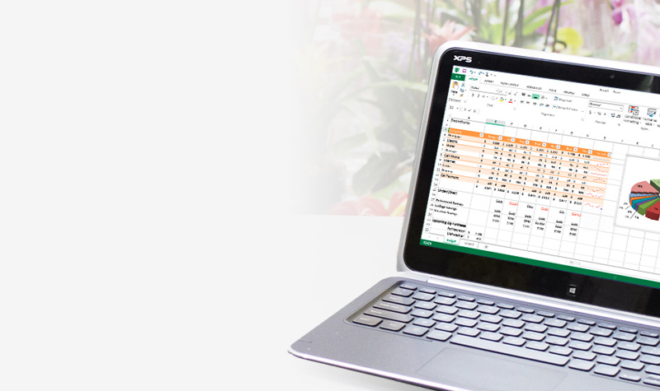
1. PC desktop applications
About 90% of personal computers use Windows. Languages include…
C#
Visual Basic
C++
and many more

Slide 3
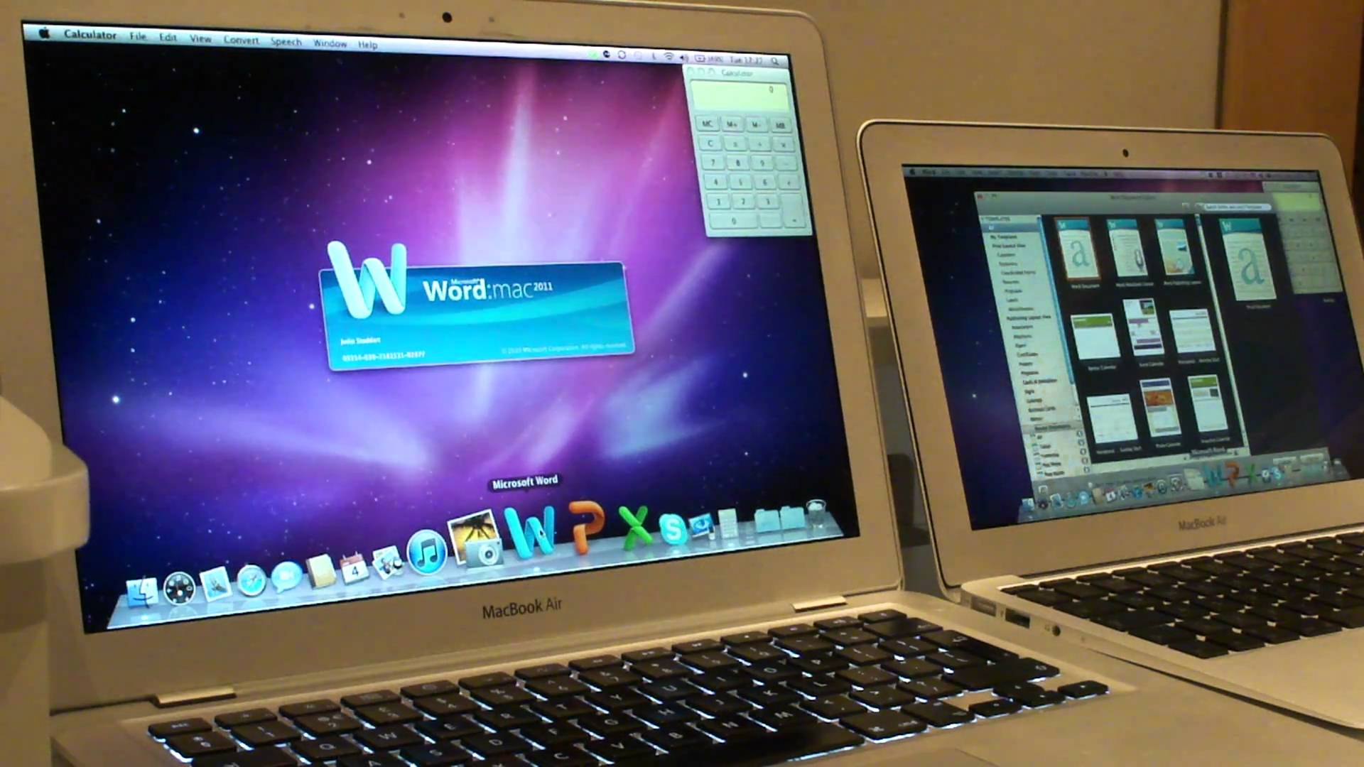
2. Mac desktop applications
About 7% of computers in the world run Apple OSX. Apple developed their own programming languages.
Objective-C
Swift

Slide 4
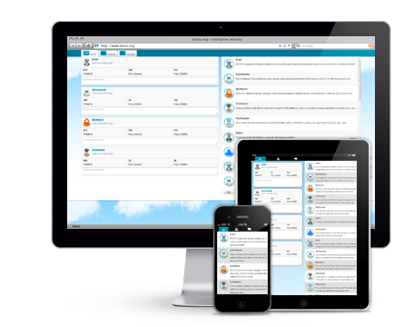
3. Web browser apps
HTML/CSS
JavaScript
Web pages can have most of the same capabilities as desktop and mobile apps.

Slide 5
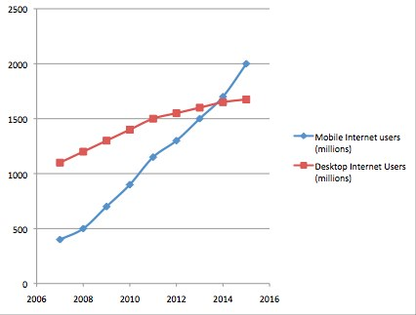
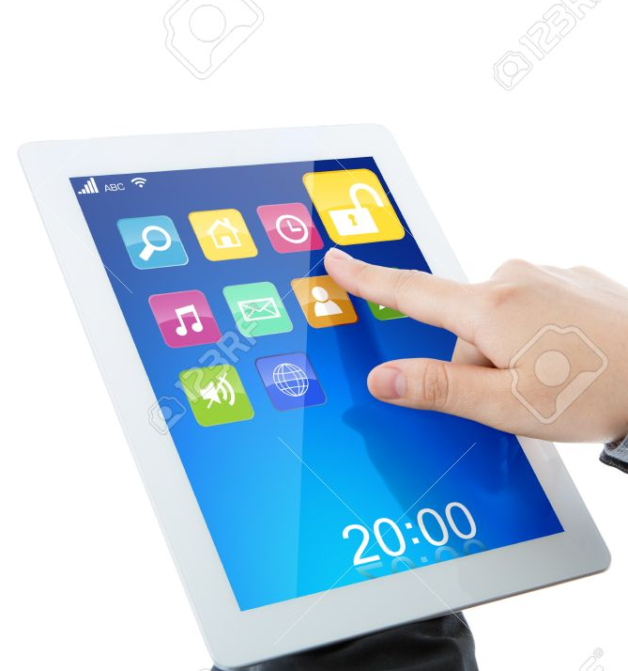
4. Mobile Apps
Mobile internet users now outnumber computer users.
Apps and website development should focus on mobile devices first.

Slide 6
4. Mobile app languages
Android (Java)
Apple iOS (Objective-C and Swift)
Cross-platform (JavaScript)
HTML/CSS web pages need to be responsive to mobile and desktop devices.

Slide 7
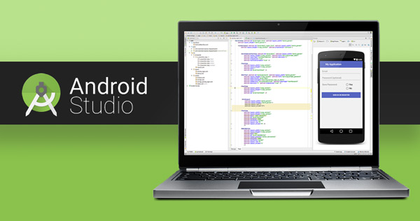
Android (Java)

Slide 8
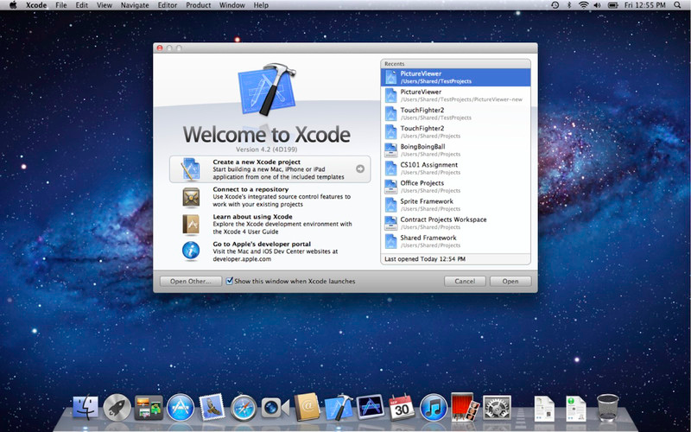
XCODE programming tool (Objective-C and Swift languages)

Slide 9
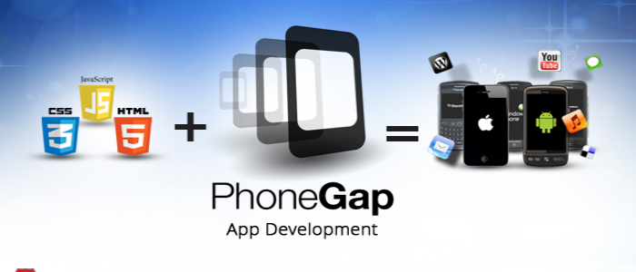
JavaScript is used more commonly for mobile app development

Slide 10
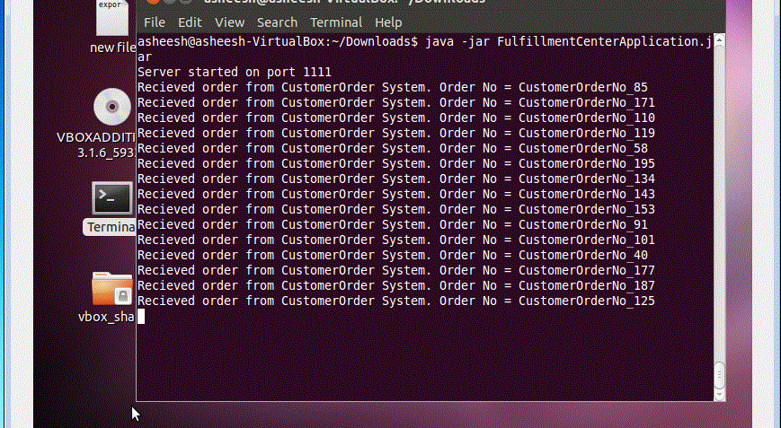
5. Server applications

Slide 11
5. Server processes
The “back end” of many applications rely on a server which you will probably never see.
Usually Windows Server or some variety of Unix.
PHP, Perl, Java, C#, C++, C, Fortran, COBOL, Ruby and many many others

Slide 12
6. Embedded Applications
Nearly every electronic device has programming embedded in its chips (Examples include microwave ovens, toys, thermostats, security systems, lawn sprinklers, automobiles, coffee makers, printers, garage door, etc)
Java, C, C++

